Slide 1

Smartpricing: A Deep Learning-Based Dynamic Pricing System For E-Commerce Entrepreneurs
Presented by,
JASNA.N.C
23MDT1011
M.Sc.Data Scienec

Slide 2
This project focuses on developing a deep learning-based dynamic pricing model for e-commerce entrepreneurs in the textile industry. The model aims to help entrepreneurs understand the value of their products in the market and make informed pricing decisions to maximize profits.
Objectives
1
Dynamic Pricing Model
2
Accurate Price Prediction
3
Robust Deep Learning Model
Develop a deep learning-based dynamic pricing model for e-commerce entrepreneurs in the textile industry, enabling them to optimize their pricing strategies for maximum profitability.
Build a model capable of accurately predicting product prices based on various features such as brand, category, and product attributes of similar products.
Identify effective methods for creating a robust deep learning model for dynamic price prediction in fashion datasets, ensuring its reliability and accuracy.

Slide 3
Literature Review
Paper | Title | Objective | Methods Used | Key Findings
Bandiet al., 2023 | Fashion E-Commerce Pricing | Joint price optimization for fashion products | Joint price optimization for fashion products | Identified optimal price points across product categories, improving demand prediction and price elasticity analysis
Kedia et al., 2020 | Fashion E-Commerce | Dynamic pricing with DRL | DRL with Markov Decision Process (MDP) and convex optimization | Developed DRL framework for dynamic pricing; used difference of revenue conversion rates (DRCR) as reward function
Liu et al., 2019 | E-Commerce Pricing | Pricing strategy optimization on e-commerce platforms | Dynamic pricing using deep reinforcement learning | Compared demand forecasting and reinforcement learning for Amazon marketplace pricing strategies

Slide 4
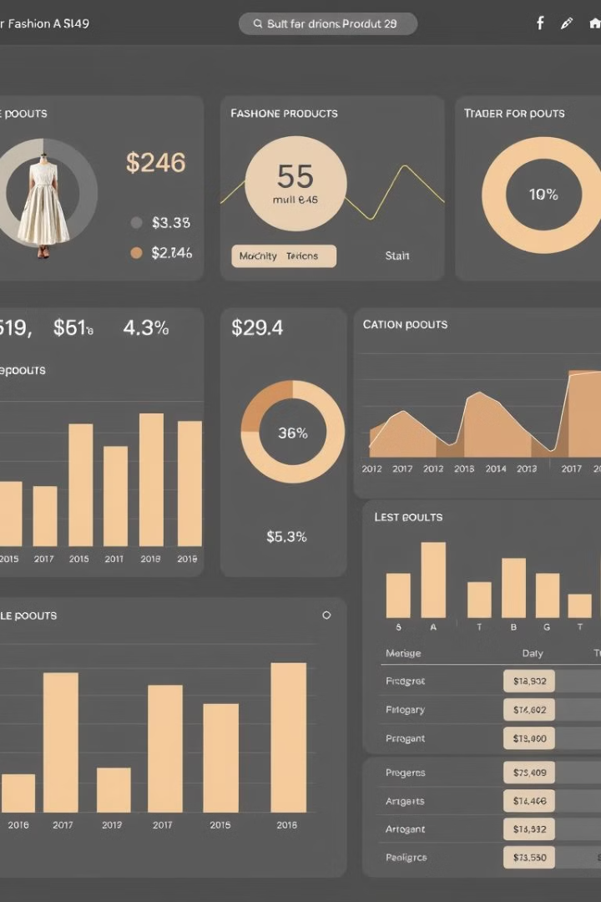
Dataset
The model is applied to the "myntra-fashion-productsdataset," which contains various attributes of fashion items. The dataset includes columns such as p_id (product identifier), name, products (category), price, color, brand, img (image URL), ratingCount, avg_rating (average rating), and description.
p_id
Unique identifier for each product
name
Name of the product
products
Category or type of product (e.g., Tops, Dresses, Footwear)
price
Price of the product
color
Color of the product
brand
Brand of the product
img
URLs to high-quality images of the product
ratingCount
Number of ratings the product has received
avg_rating
Average rating of the product
description
Detailed description of the product

Slide 5
Methodology
Data Collection and Preprocessing
Feature Engineering
Feature Scaling
Log transformation is applied to the 'price' column to normalize the distribution. The data is split into training and testing sets in an 80:20 ratio.
Standardization is performed using a 'StandardScaler' to scale features with a mean of 0 and a standard deviation of 1.
The "Myntra Fashion Products" dataset is used, and features are extracted from the product name and 'products' column. Irrelevant columns are dropped, and categorical features are one-hot encoded.

Slide 6
Architecture
The model is built using the 'Sequential API' in Keras, designed to predict a continuous target (price) based on input features. The architecture consists of input layers, hidden layers, dropout layers, and an output layer.
The input layer has 128 neurons with ReLU activation. Hidden layers have 64 neurons with ReLU activation. Dropout layers are applied after each dense layer at a rate of 0.2. The output layer has a single neuron with a linear activation function for continuous price prediction.

Slide 7
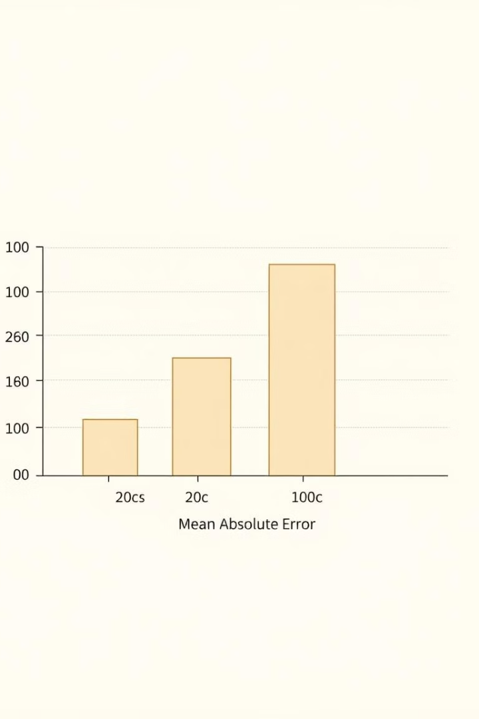
Evaluation and Conclusion
The model is evaluated using Mean Absolute Error (MAE) on the test set. The model achieved a MAE of 0.4108, indicating a high level of accuracy in price prediction. The model's ability to predict prices within 10% of the actual price with an accuracy of 84.12% demonstrates its practical applicability in dynamic pricing.
The research concludes that the neural network model effectively predicts dynamic pricing, showcasing the benefits of one-hot encoding, log transformation, and early stopping techniques. The model's ability to generalize to new data without prior exposure highlights its potential for real-world applications in e-commerce.

Slide 8
Future Work
Feature Augmentation: Add more elements like season ality, marketing promotions, and competitor rates to improve the precision of the model, i.e. its predictions.
Advanced Models: Try out more advanced methods, such as Gradient Boosting Machines (GBM) or Transformer based approaches, to achieve enhanced performance.
Hyperparameter Optimization: Carry out a comprehensive hyperparameter optimization exercise using Grid Search or Bayesian Optimization technique in order to enhance further the predictive ability of the model.
On-Demand Modelling: Incorporate a mechanism that will enable data refresh and model retraining on demand so that the pricing model remains relevant as per the trends in the market

Slide 9
THANK YOU

